Slide 1
Need to update
Add more content on plant

Slide 2
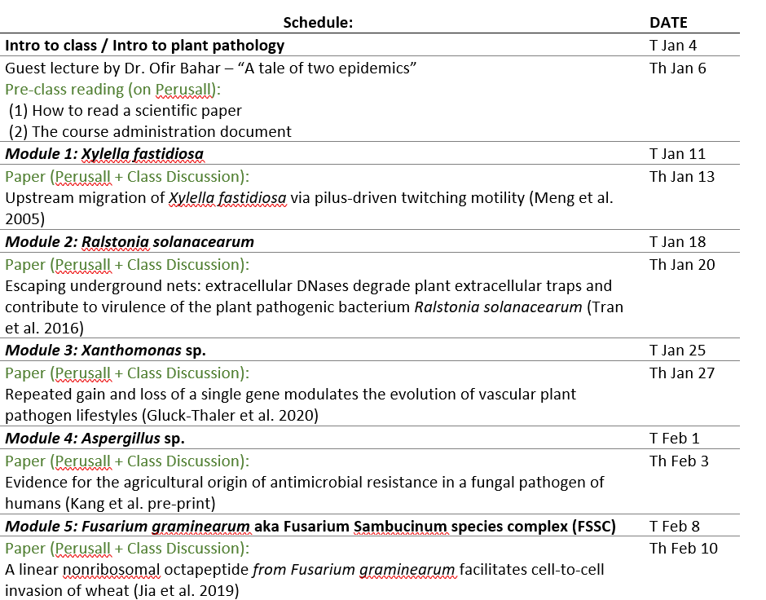
First Perusall reading is Due
(Tues Jan 11)
Update

Slide 3
Welcome to PLP100 Biology of Plant Pathogens
Lecture 2
Why should you take PLP100 “Biology of Plant Pathogens”?
You are interested in plant health / plant pathology / food security
You interested in learning about Infectious Diseases while gaining experience reading and trying to understand scientific literature through peer discussions
You are interested in a career in biological research

Slide 4
Content
What is plant pathology
Questions to guide understanding of plant pathogens

Slide 5
What is plant pathology?
Physiology and genetics of pathogens
Population genetics
Disease Diagnosis
Physiology and genetics of host susceptibility & resistance
Evolution
Ecology
Disease control and management
Epidemiology

Slide 6
What does this class focus on?
Physiology and genetics of pathogens
Population genetics
Disease Diagnosis
Physiology and genetics of host susceptibility & resistance
Evolution
Ecology
Disease control and management
Epidemiology

Slide 7
Definitions of the fields
Skip! This is just for your information
Population Genetics/Genomics: the study of the genetic composition of populations, including distributions and changes in genotype and phenotype frequency in response to the processes of natural selection, genetic drift, mutation and gene flow.
Physiology: branch of biology that deals with the normal functions of living organisms and their parts.
Molecular Biology and Genetics seek to understand how the molecules/genes that make up cells determine behavior (phenotypes).
Ecology: branch of biology that deals with the relations of organisms to one another and to their physical surroundings.
Epidemiology: branch of disease fields that deals with the incidence, distribution, and possible control of diseases and other factors relating to plant or animal health.
Evolution: the subfield of biology that studies the evolutionary processes (natural selection, common descent, speciation) that produced the diversity of life on Earth.

Slide 8
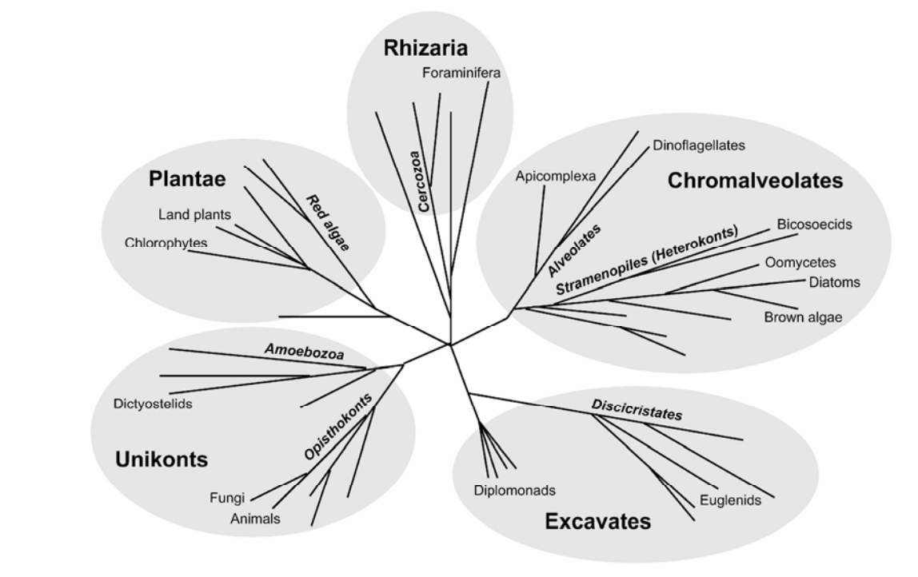

What are the groups of Plant Pathogens?
Eukaryotes
Bacteria
Xylella fastidiosa
Ralstonia solanacearum
Xanthomonas sp.
Oomycetes
Phytophthora infestans
Viruses
Nematodes
Cassava Brown Streak Virus
Banana streak virus
Fungi
Fusarium graminearum
Aspergillus
Which example pathogens will we focus on in this course?
Update
Notes:
I always like to know the evolutionary neighborhood of microbes. Ralstonia is a gram-negative beta-proteobacteria rod. It’s a cousin to Burkholderia which is becoming an emerging infectious disease of humans.

Slide 9
Questions to guide understanding of plant pathogens
Tip for studying for the Final exam: If you can answer these questions, you are likely to do well on the exam
How does the pathogen find the plant host (active) / arrive at the host (passive)?
Does the pathogen live on the surface of the plant prior to invasive infection?
How does the pathogen invade the plant tissue?

Slide 10
Questions to guide understanding of plant pathogens
Does the pathogen move within the plant? If so, how?
How does the pathogen acquire nutrients?
How does the pathogen evade / resist / manipulate host immunity?

Slide 11
Questions to guide understanding of plant pathogens
What symptoms does the pathogen cause?
How does the pathogen exit the host?
How does the pathogen survive outside of the host? What are the reservoirs?

Slide 12
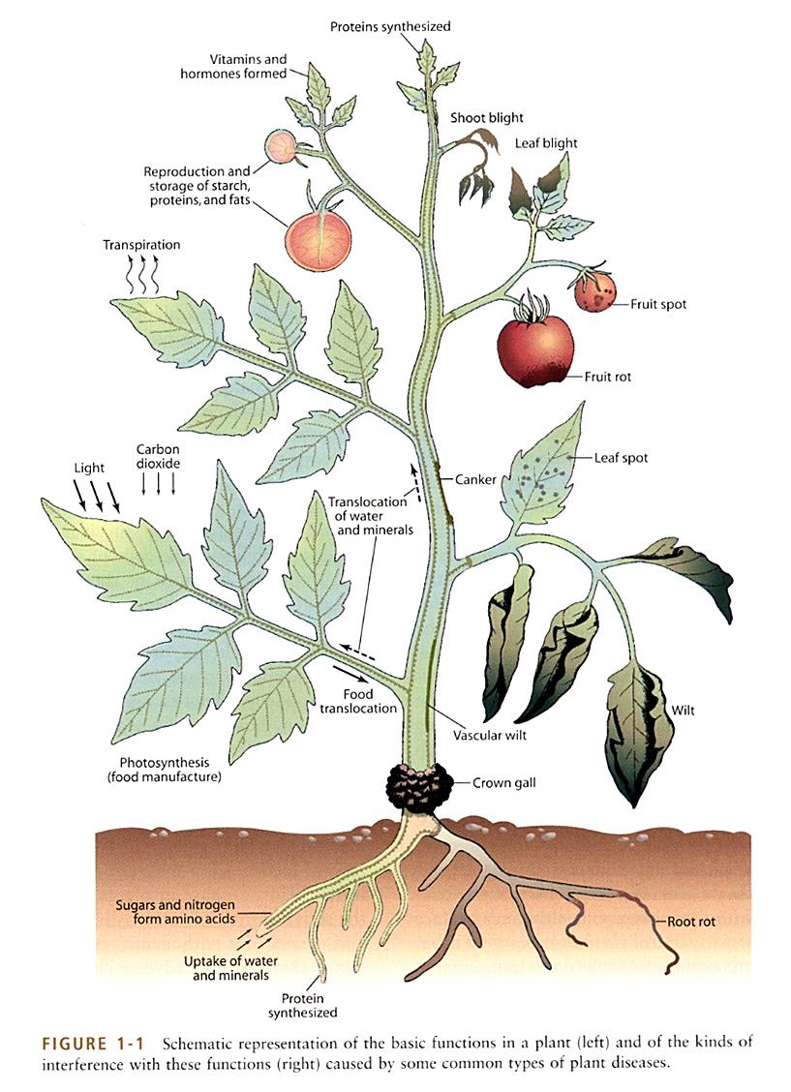
Plants are an ecosystem for microbial communities
Where can microbes live in plants? Participation question
Organs
Tissues
Stems
Xylem
Fruits
Phloem
Flowers
Stems
Apoplast
Leaves
Roots
Tubers

Slide 13

Plants are an ecosystem for microbial communities
Phyllosphere the total above-ground surface of a plant when viewed as a habitat for microorganisms.
Root System Roots+Rhizosphere

Slide 14
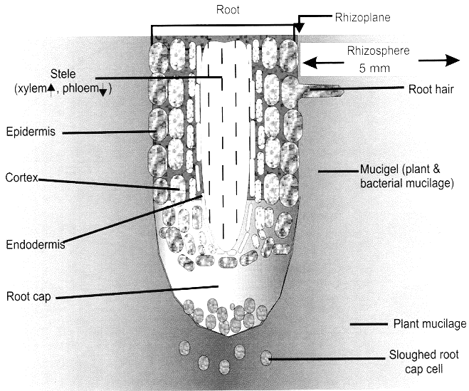
Root anatomy
Vascular system
Microbial community
Root border cell

Slide 15
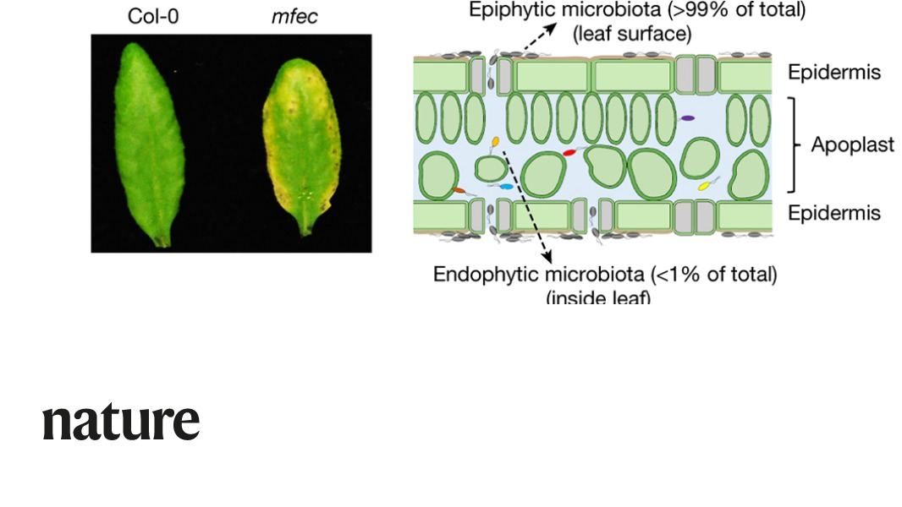
Plants are an ecosystem for microbial communities
Epiphytic bacteria colonize the surfaces
(phyllosphere, rhizosphere, etc)
Apoplast
Endophytic bacteria colonize the inside: apoplast, xylem, phloem, and/or root cortex

Slide 16

Plants are an ecosystem for microbial communities
Why do microbes live on and in plants? Participation question
Leaves release volatile organic carbon (VOCs) from stomata.
Food, shelter
Plants release up to 20% of all photosynthate through their roots

Slide 17
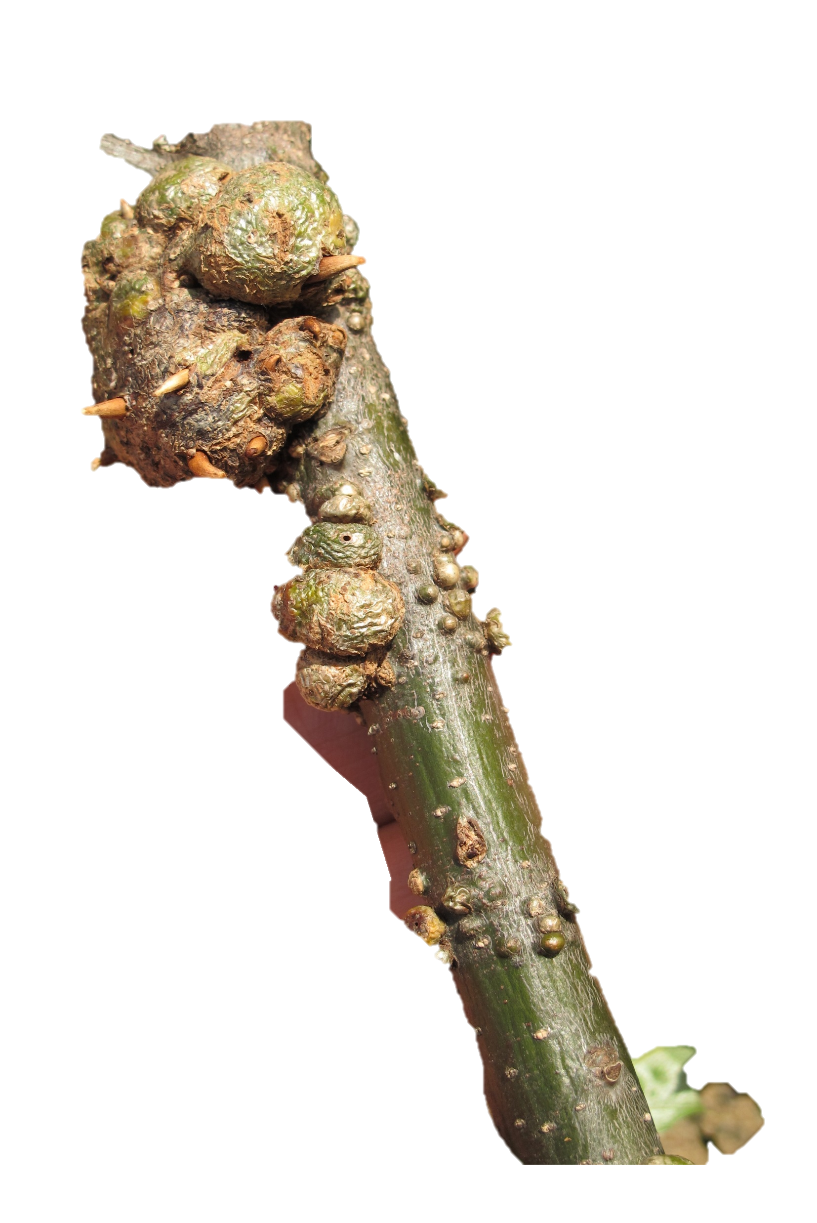
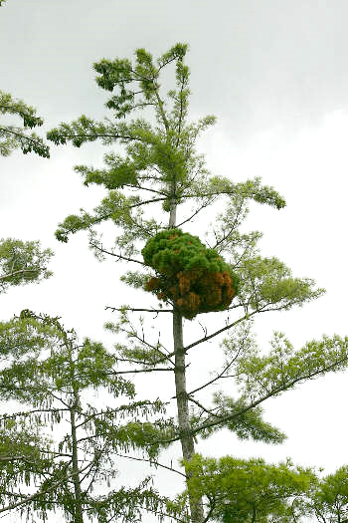
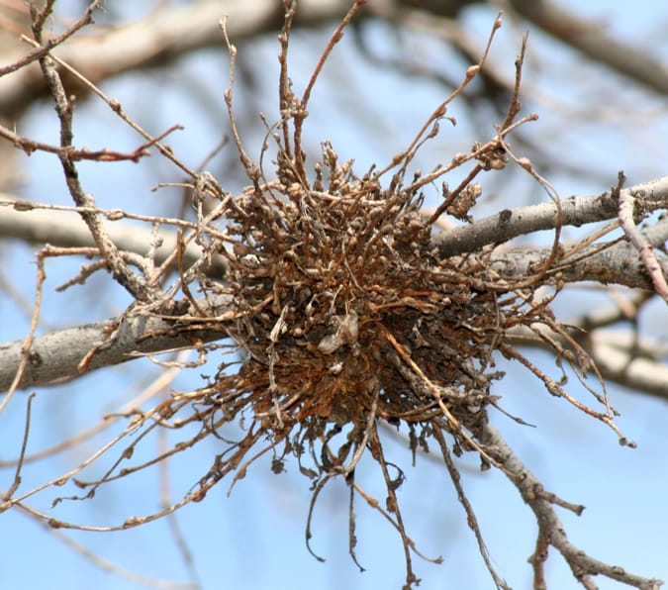
Disease physiology
Process affected: Growth
Too little:
Stunting (very common)
Defoliation
Too Much:
Galls: abnormal plant growths (tumor or wart-like)
witches’ brooms: abnormal brushlike cluster of dwarfed weak shoots arising at or near the same point
bunchytop

Slide 18
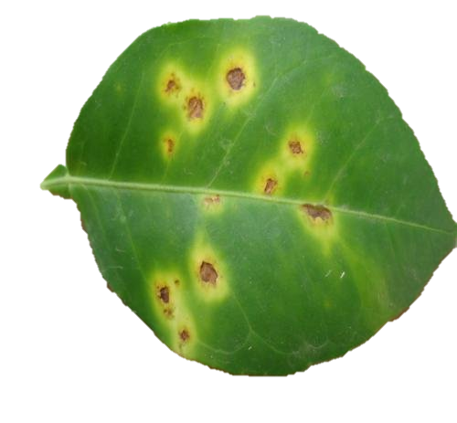
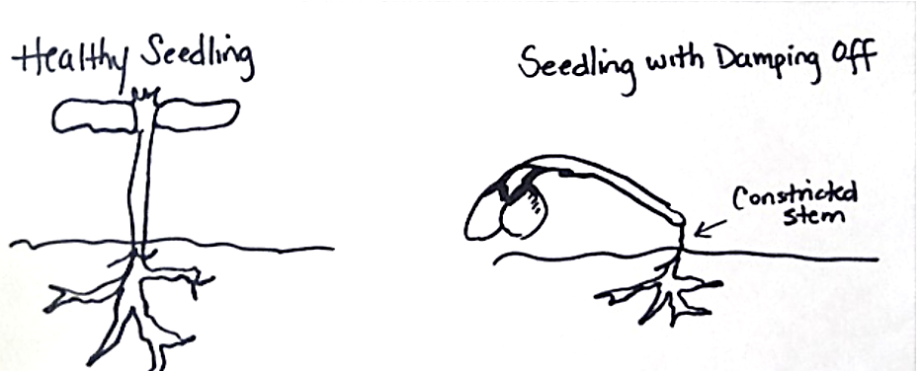
Disease physiology
Process impaired: Photosynthesis
Symptoms: chlorosis, necrosis
Process impaired: Carbohydrate storage
Symptoms: reduced yield, # and size of fruit, tuber, seeds …
Process impaired: Using stored carbohydrates
Types of diseases
Rots of Carb-storing tissues (tuber, seed or fruit rots)
damping off of seedlings

Slide 19
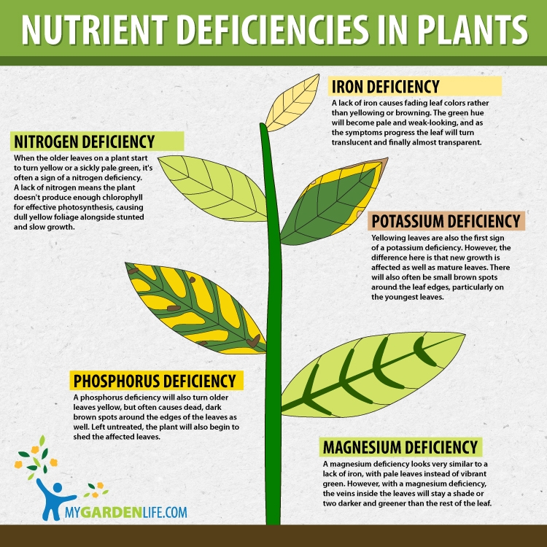
Disease physiology
Process impaired: Nutrient translocation through phloem
Symptoms: (looks like abiotic nutrient deficiencies)
Types of diseases
viruses
phloem pathogenic bacteria
Canker pathogens

Slide 20
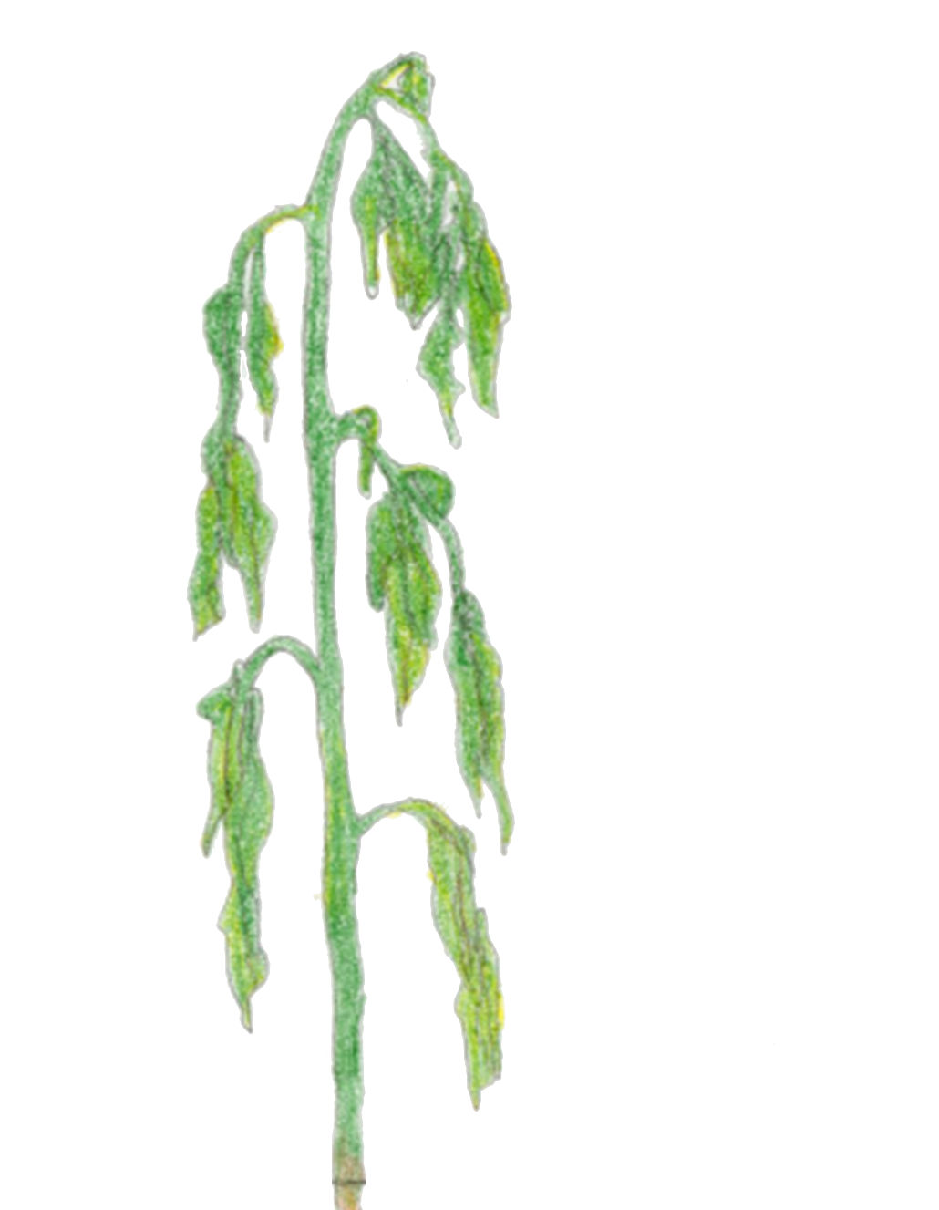
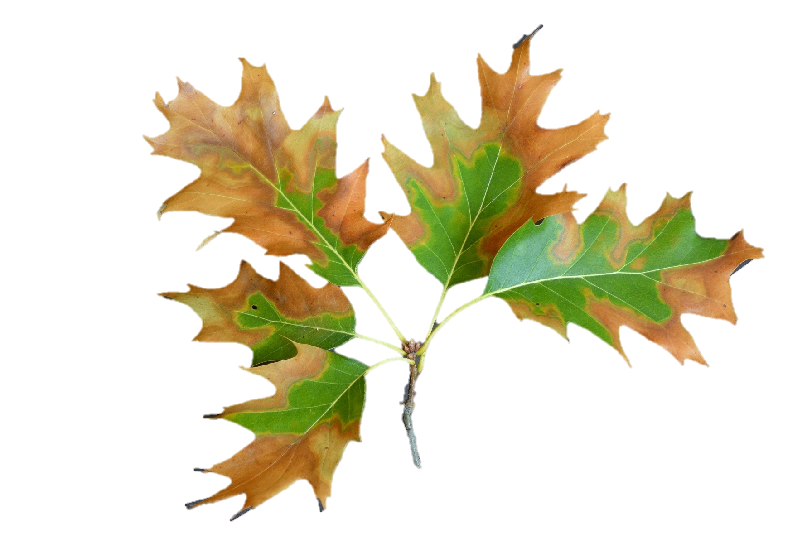
Disease physiology
Process affected: Water/nutrient uptake by roots
Types of diseases
Root pathogens / root rots
Process affected: Water transport by xylem
Types of symptoms
Wilt (loss of turgidity)
Leave scorch (necrosis on leaf edges)

Slide 21
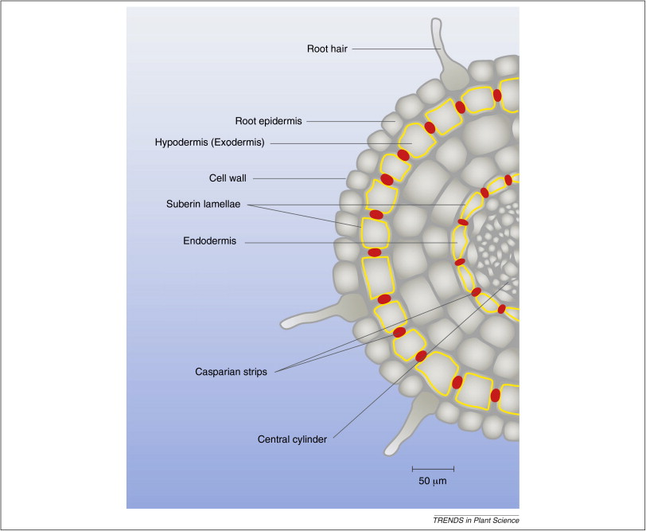
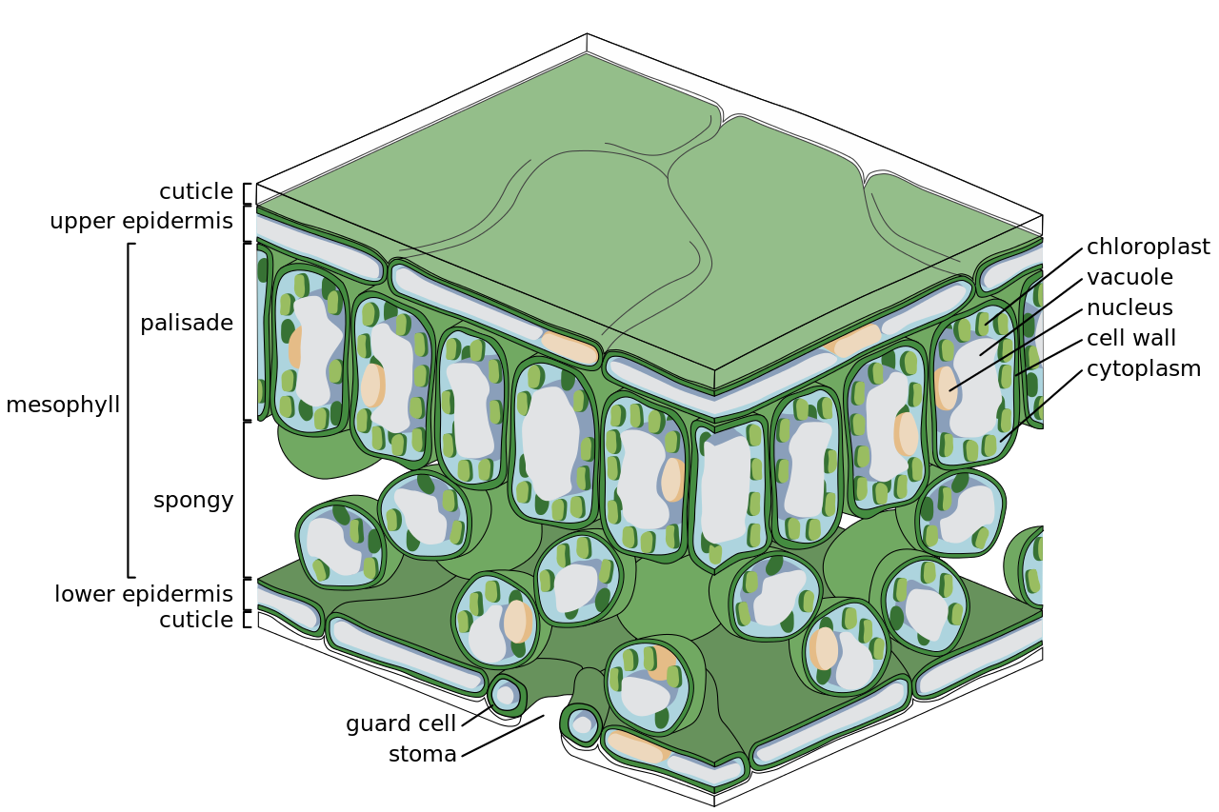
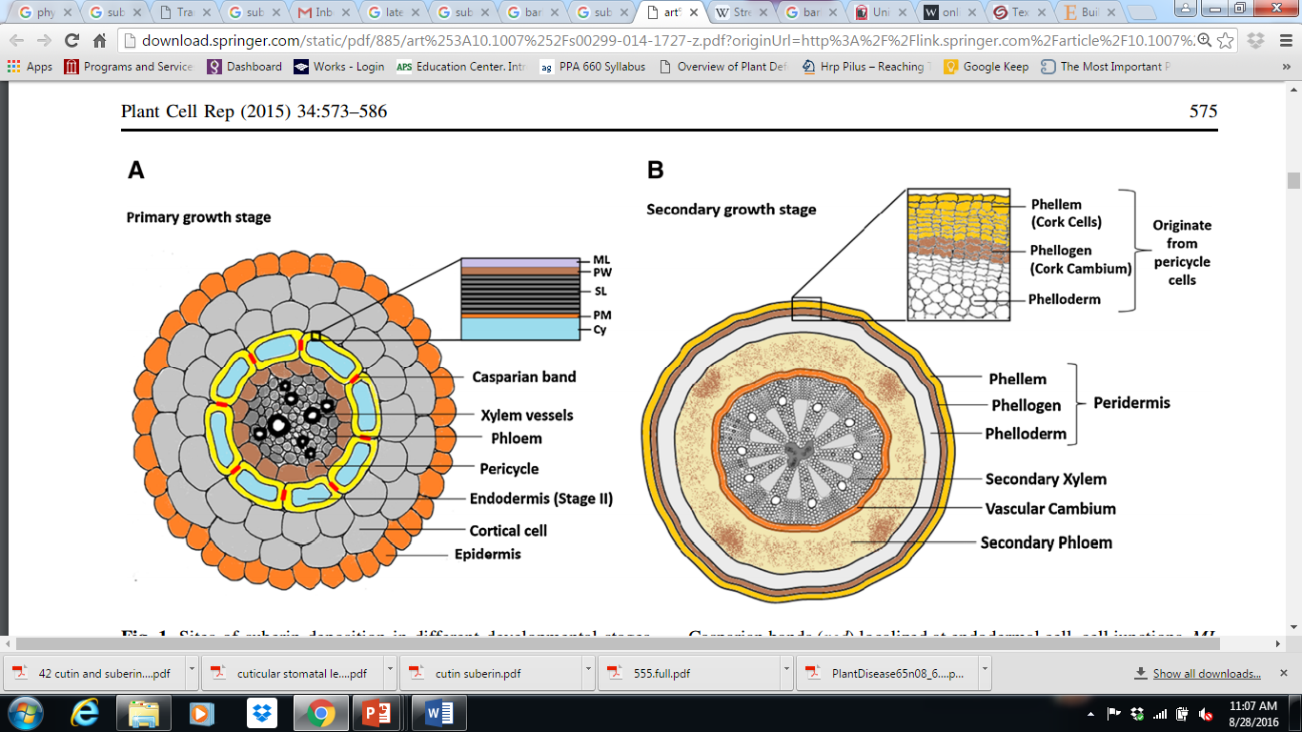

How do plants defend themselves from pathogens?
1. Physical barriers
Herbaceous tissues
Wood:
Lignin & Cork
(Suberin, cutin-like polymer)
Roots:
Lignin & Suberin
Cuticle
Cutin: waxy polymer
lignified

Slide 22
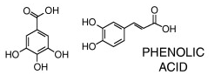
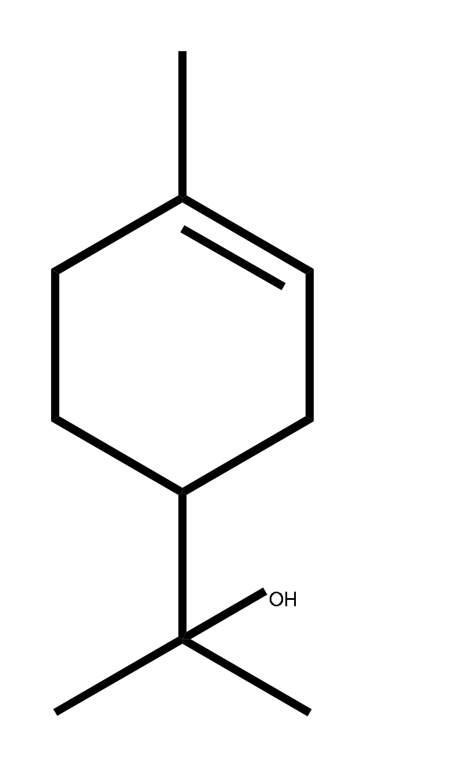
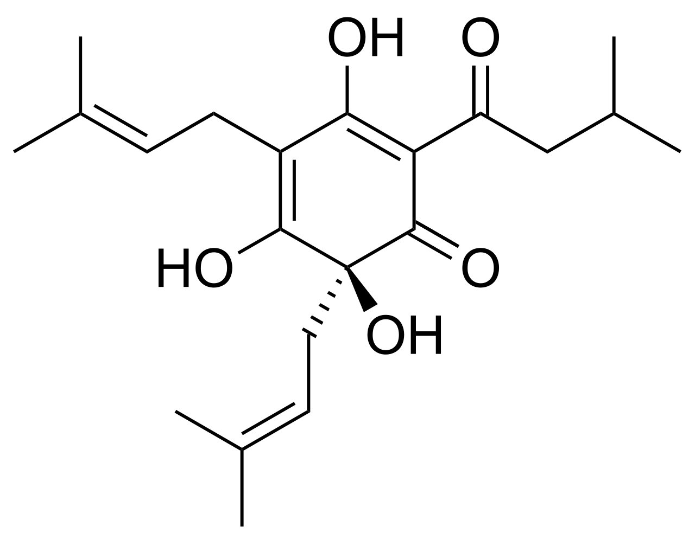
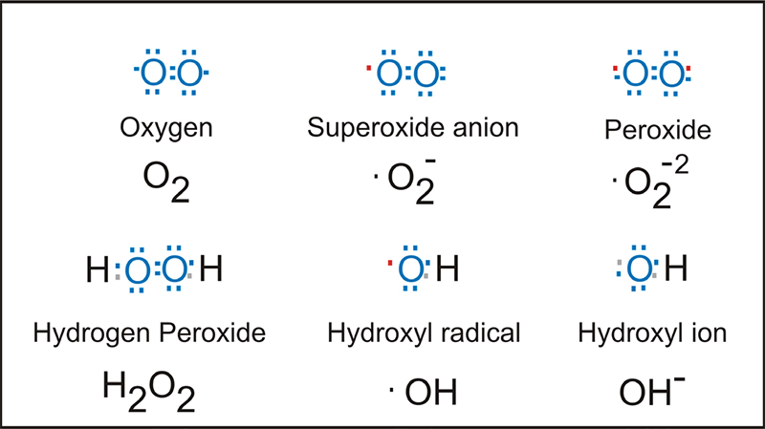
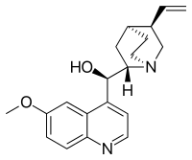
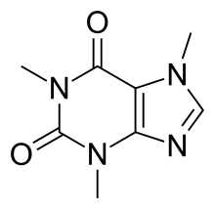
How do plants defend themselves from pathogens?
2. Chemical defenses
Phenolics
Terpenoids
Reactive oxygen species:
Alkaloids

Slide 23
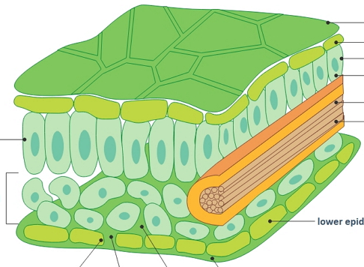
How do plants defend themselves from pathogens?
3. Sequester nutrients

Slide 24
How do plants defend themselves from pathogens?
4. Immunity
Recognition of the pathogen or damage from the pathogens
Protein receptors on plasma membrane & in cytoplasm
Signaling cascade → Changes in gene expression
Change in physiology:
Increased physical defenses (Callose polymer)
Increased chemical defenses
Less nutrients
Removal of water

Slide 25
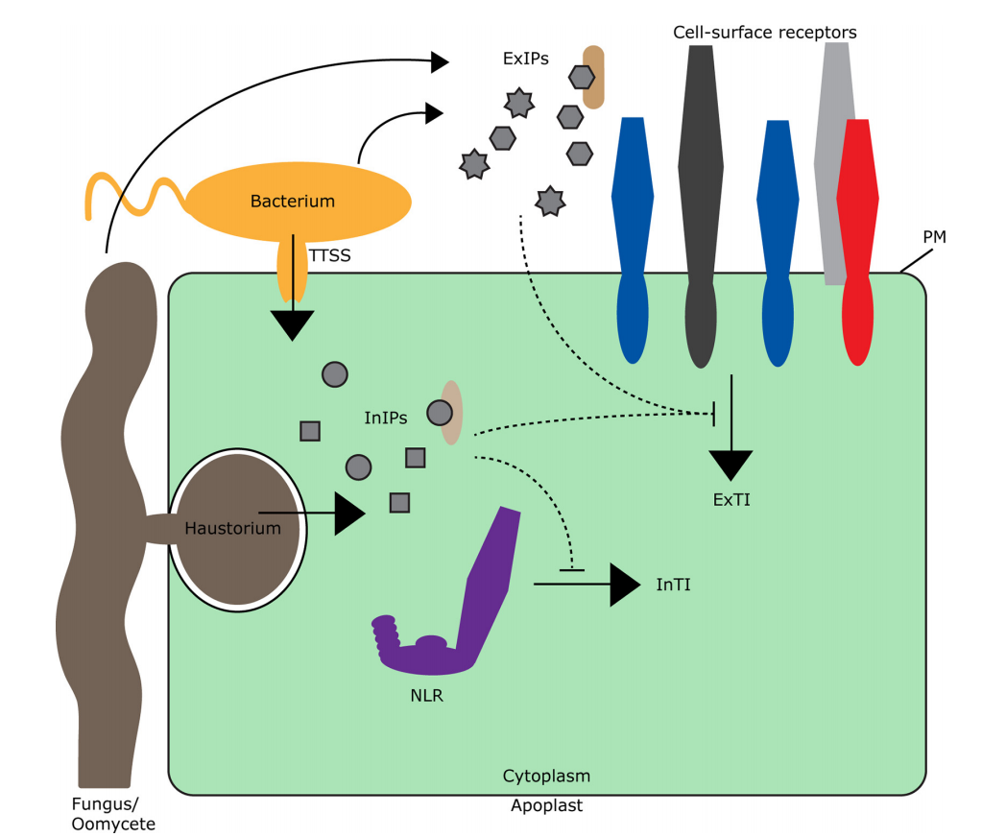
Recognition: Plant Immunity Receptors
Cell Surface Receptors
Pattern Recognition
Receptors (PRRs)
Plasma membrane
Phosphorylation
cascade
Immunity gene expression
Intracellular Receptors
Nucleus
Notes:
Extracellular immunogenic patterns (ExIPs), which accumulate upon attack of the plant by microbes or as a result of cellular damage, are sensed by cell-surface receptors on the plasma membrane (PM). ExIPs are so-called danger signals, which can be either pathogen-derived patterns and effectors or host-derived damage-associated molecular patterns (shown as grey structures outside the cell) and effector-modified host-derived virulence targets (VTs) (brown structure). Intracellular immunogenic patterns (InIPs) are danger signals that are sensed by cytoplasmic receptors, mostly nucleotide-binding leucine-rich repeat receptors (NLRs). InIPs can be pathogen-derived molecules (shown as grey structures inside the cell) or modified VTs (light brown structure). Both ExIP and InIP recognition leads to the activation of host defense responses, referred to as extracellularly and intracellularly triggered immunity (ExTI and InTI), respectively. ExIPs can act as effectors, and by their action in the extracellular space they can suppress or circumvent the activation of ExTI (dotted line from the apoplast to the cytoplasm). InIPs can also act as effectors, with the potential to suppress immunity triggered by cell-surface as well as cytoplasmic receptors (dotted lines in the cytoplasm). Picture inspired by Dodds and Rathjen [65]. Abbreviation: TTSS, type three secretion system.

Slide 26

Cell Surface Receptors (Pattern Recognition Receptors PRRs) recognize microbial patterns in the extracellular space & induce mild-to-moderate immune response
MAMPS
Pattern Recognition
Receptors (PRRs)
MAMPS: Microbial associated molecular patterns
Plasma membrane
Phosphorylation
cascade
Immunity gene expression
Nucleus
Notes:
Extracellular immunogenic patterns (ExIPs), which accumulate upon attack of the plant by microbes or as a result of cellular damage, are sensed by cell-surface receptors on the plasma membrane (PM). ExIPs are so-called danger signals, which can be either pathogen-derived patterns and effectors or host-derived damage-associated molecular patterns (shown as grey structures outside the cell) and effector-modified host-derived virulence targets (VTs) (brown structure). Intracellular immunogenic patterns (InIPs) are danger signals that are sensed by cytoplasmic receptors, mostly nucleotide-binding leucine-rich repeat receptors (NLRs). InIPs can be pathogen-derived molecules (shown as grey structures inside the cell) or modified VTs (light brown structure). Both ExIP and InIP recognition leads to the activation of host defense responses, referred to as extracellularly and intracellularly triggered immunity (ExTI and InTI), respectively. ExIPs can act as effectors, and by their action in the extracellular space they can suppress or circumvent the activation of ExTI (dotted line from the apoplast to the cytoplasm). InIPs can also act as effectors, with the potential to suppress immunity triggered by cell-surface as well as cytoplasmic receptors (dotted lines in the cytoplasm). Picture inspired by Dodds and Rathjen [65]. Abbreviation: TTSS, type three secretion system.

Slide 27
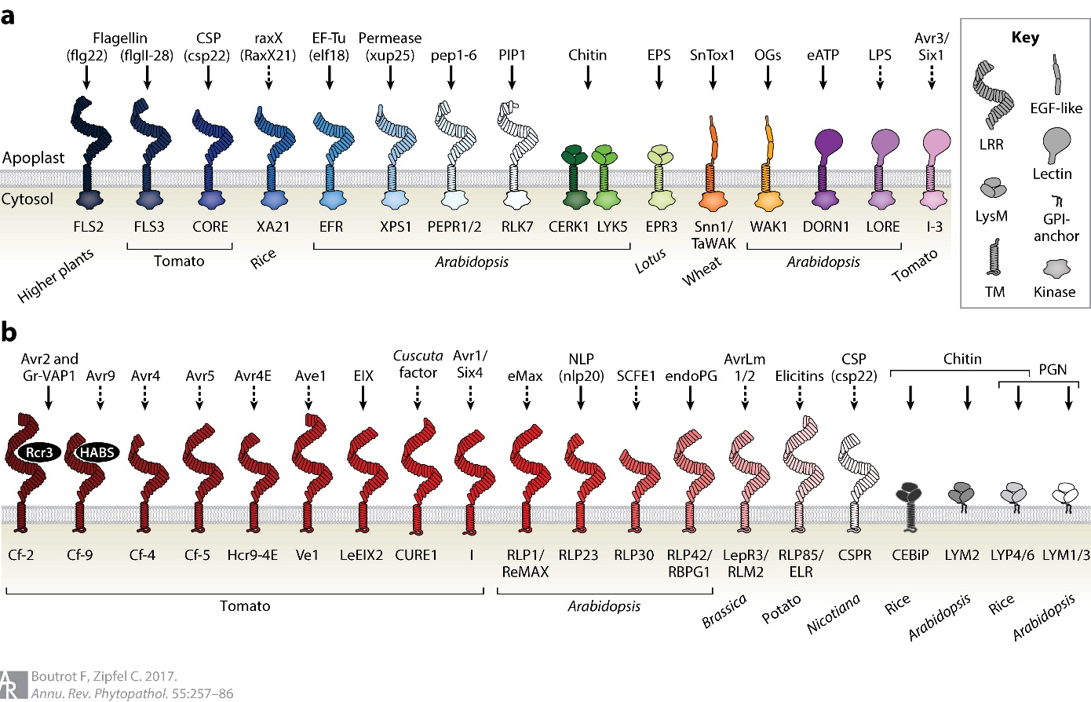
MAMPs and Surface Receptors that recognize them
Plants have variation in immune receptors

Slide 28
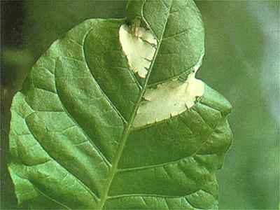


Plant Immunity has multiple tiers.
Pathogens inject into plant cytoplasm (to manipulate host)
NLRs recognize proteins that Intracellular detection = “big threat”. Closely-adapted microbes are usually parasites.
Strong immunity is induced
Programmed Cell Death
Immunity gene expression
NLR
Intracellular Receptors
Nucleus
Notes:
Extracellular immunogenic patterns (ExIPs), which accumulate upon attack of the plant by microbes or as a result of cellular damage, are sensed by cell-surface receptors on the plasma membrane (PM). ExIPs are so-called danger signals, which can be either pathogen-derived patterns and effectors or host-derived damage-associated molecular patterns (shown as grey structures outside the cell) and effector-modified host-derived virulence targets (VTs) (brown structure). Intracellular immunogenic patterns (InIPs) are danger signals that are sensed by cytoplasmic receptors, mostly nucleotide-binding leucine-rich repeat receptors (NLRs). InIPs can be pathogen-derived molecules (shown as grey structures inside the cell) or modified VTs (light brown structure). Both ExIP and InIP recognition leads to the activation of host defense responses, referred to as extracellularly and intracellularly triggered immunity (ExTI and InTI), respectively. ExIPs can act as effectors, and by their action in the extracellular space they can suppress or circumvent the activation of ExTI (dotted line from the apoplast to the cytoplasm). InIPs can also act as effectors, with the potential to suppress immunity triggered by cell-surface as well as cytoplasmic receptors (dotted lines in the cytoplasm). Picture inspired by Dodds and Rathjen [65]. Abbreviation: TTSS, type three secretion system.

Slide 29
Disease Triangle – a Key concept in infectious diseases
Disease is the interaction of:
Host
Pathogen
Disease
Environment

Slide 30
Happens every day, but we don’t notice
Visible:
Non-conducive environment
Resistant/Tolerant host
Host
Pathogen
Pathogen
Host
Host
Pathogen
Environment
Disease
Environment
Weak pathogen
Host
Pathogen
Environment
Environment

Slide 31
Happens every day, but we don’t notice
Visible:
Corn,
wheat
Fusarium
graminearum
Apples,
Zucchini
Host
Pathogen
Pathogen
Host
Fusarium
Head blight
Host
Pathogen
Environment
Disease
Environment
A different Fusarium sp.
Warm, wet weather
Wounds on grain
Host
Pathogen
Environment
Dry heat
Wet but cold
Environment

Slide 32
Disease Triangle, extended as a polyhedral
Additional dimensions of disease:
Time
Host
Pathogen
Management Practices
Other organisms in ecosystem:
Microbiota
Insect vectors
Herbivores
Disease
Environment

Slide 33
First Perusall reading is Due
(Tues Jan 11)
Update

Slide 34
Any questions?

